Slide 1
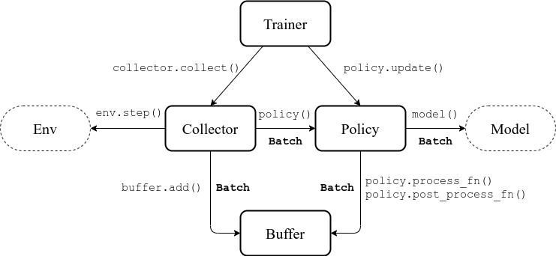
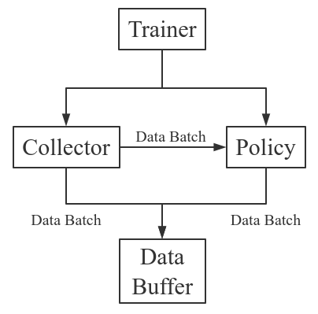

Slide 2
env.step()
policy.forward()
Reward
Action
Optimizer
Training Env
SimulatedEnv()
Collector
batched actions, values
loss.backward()
Policy
optim.step()
User Model
collector.collect()
buffer.add()
State
batched states
prepare_user_model()
get_emb()
DataLoader
Buffer
State Tracker
Planning
Training Data
buffer.sample()
Learning
batched actions, values
Buffer
Optimizer
get_training_data()
policy.forward()
loss.backward()
Policy
optim.step()
DataLoader
buffer.sample()
batched states
get_emb()
Training Data
State Tracker
policy.forward()
Results
①: Directly construct test environments.
②: Synthesize missing behaviors.
env.step()
Action
Logger
Reward
Test Env
Policy
Option ②
State
Option ①
Simulation Model
get_emb()
Collector
Collector
Collector
State Tracker
get_true_env()
Buffer
DataLoader
Buffer
Buffer
CollectorSet
Test Data

Slide 3
















A set of correct answer (purchased items) for user $u_{0}$
The only correct answer at each timestamp t
Evaluate on the cumulative reward
…
A trajectory
…
…
…
0
9
4
$r$=0.8
$r$=0.5
$r$=0.4
End
Evaluate on metrics, e.g., Recall, NDCG, Hit Rate.
1
2
3
4
5
7
5
2
$r$=0.7
Rewards and End signals are provided by environment (users)
End
1
Recommended top-$k$ items
$r$=0.3
$r$=0.2
$r$=0.4
9
3
6
$r$=0.4
End
Model
Sequential model
$r$=0.5
$r$=0.6
Actions are generated by the RL model.
3
1
8
User
$$u_{0}$$
$$u_{0}$$
0
1
2
3
4
$$u_{0}$$
(a) Static Recommendation
(b) Sequential Recommendation
(c) Interactive Recommendation

Slide 4








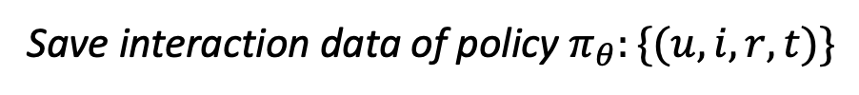


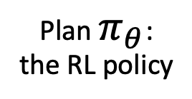





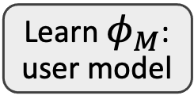



Offline Learning
Online Serving
Sample data from historical policies
Buffer $𝒟$
$$s,r$$
Historical Interactions
Learn $φ_{M}$: user model
Interaction
$$s,r$$
$$s,r$$
$$s,r$$
$$π_{θ}$$
Interaction
Interaction
$$a$$
Interaction
$$π_{β^{1}}$$
$$π_{β^{1}}$$
Plan $π_{θ}$: the RL policy
$$a$$
$$π_{β^{1}}$$
$$a$$
$$a$$
Save interaction data of policy $π_{θ}:\{(u,i,r, t)\}$

Slide 5
batched actions, values
Buffer
Optimizer
get_training_data()
policy.forward()
loss.backward()
Policy
optim.step()
DataLoader
buffer.sample()
batched states
get_emb()
Training Data
State Tracker
Policy:
BCQ
CQL
CRR
SQN
State Tracker:
Average
GRU
SASRec
Caser

Slide 6
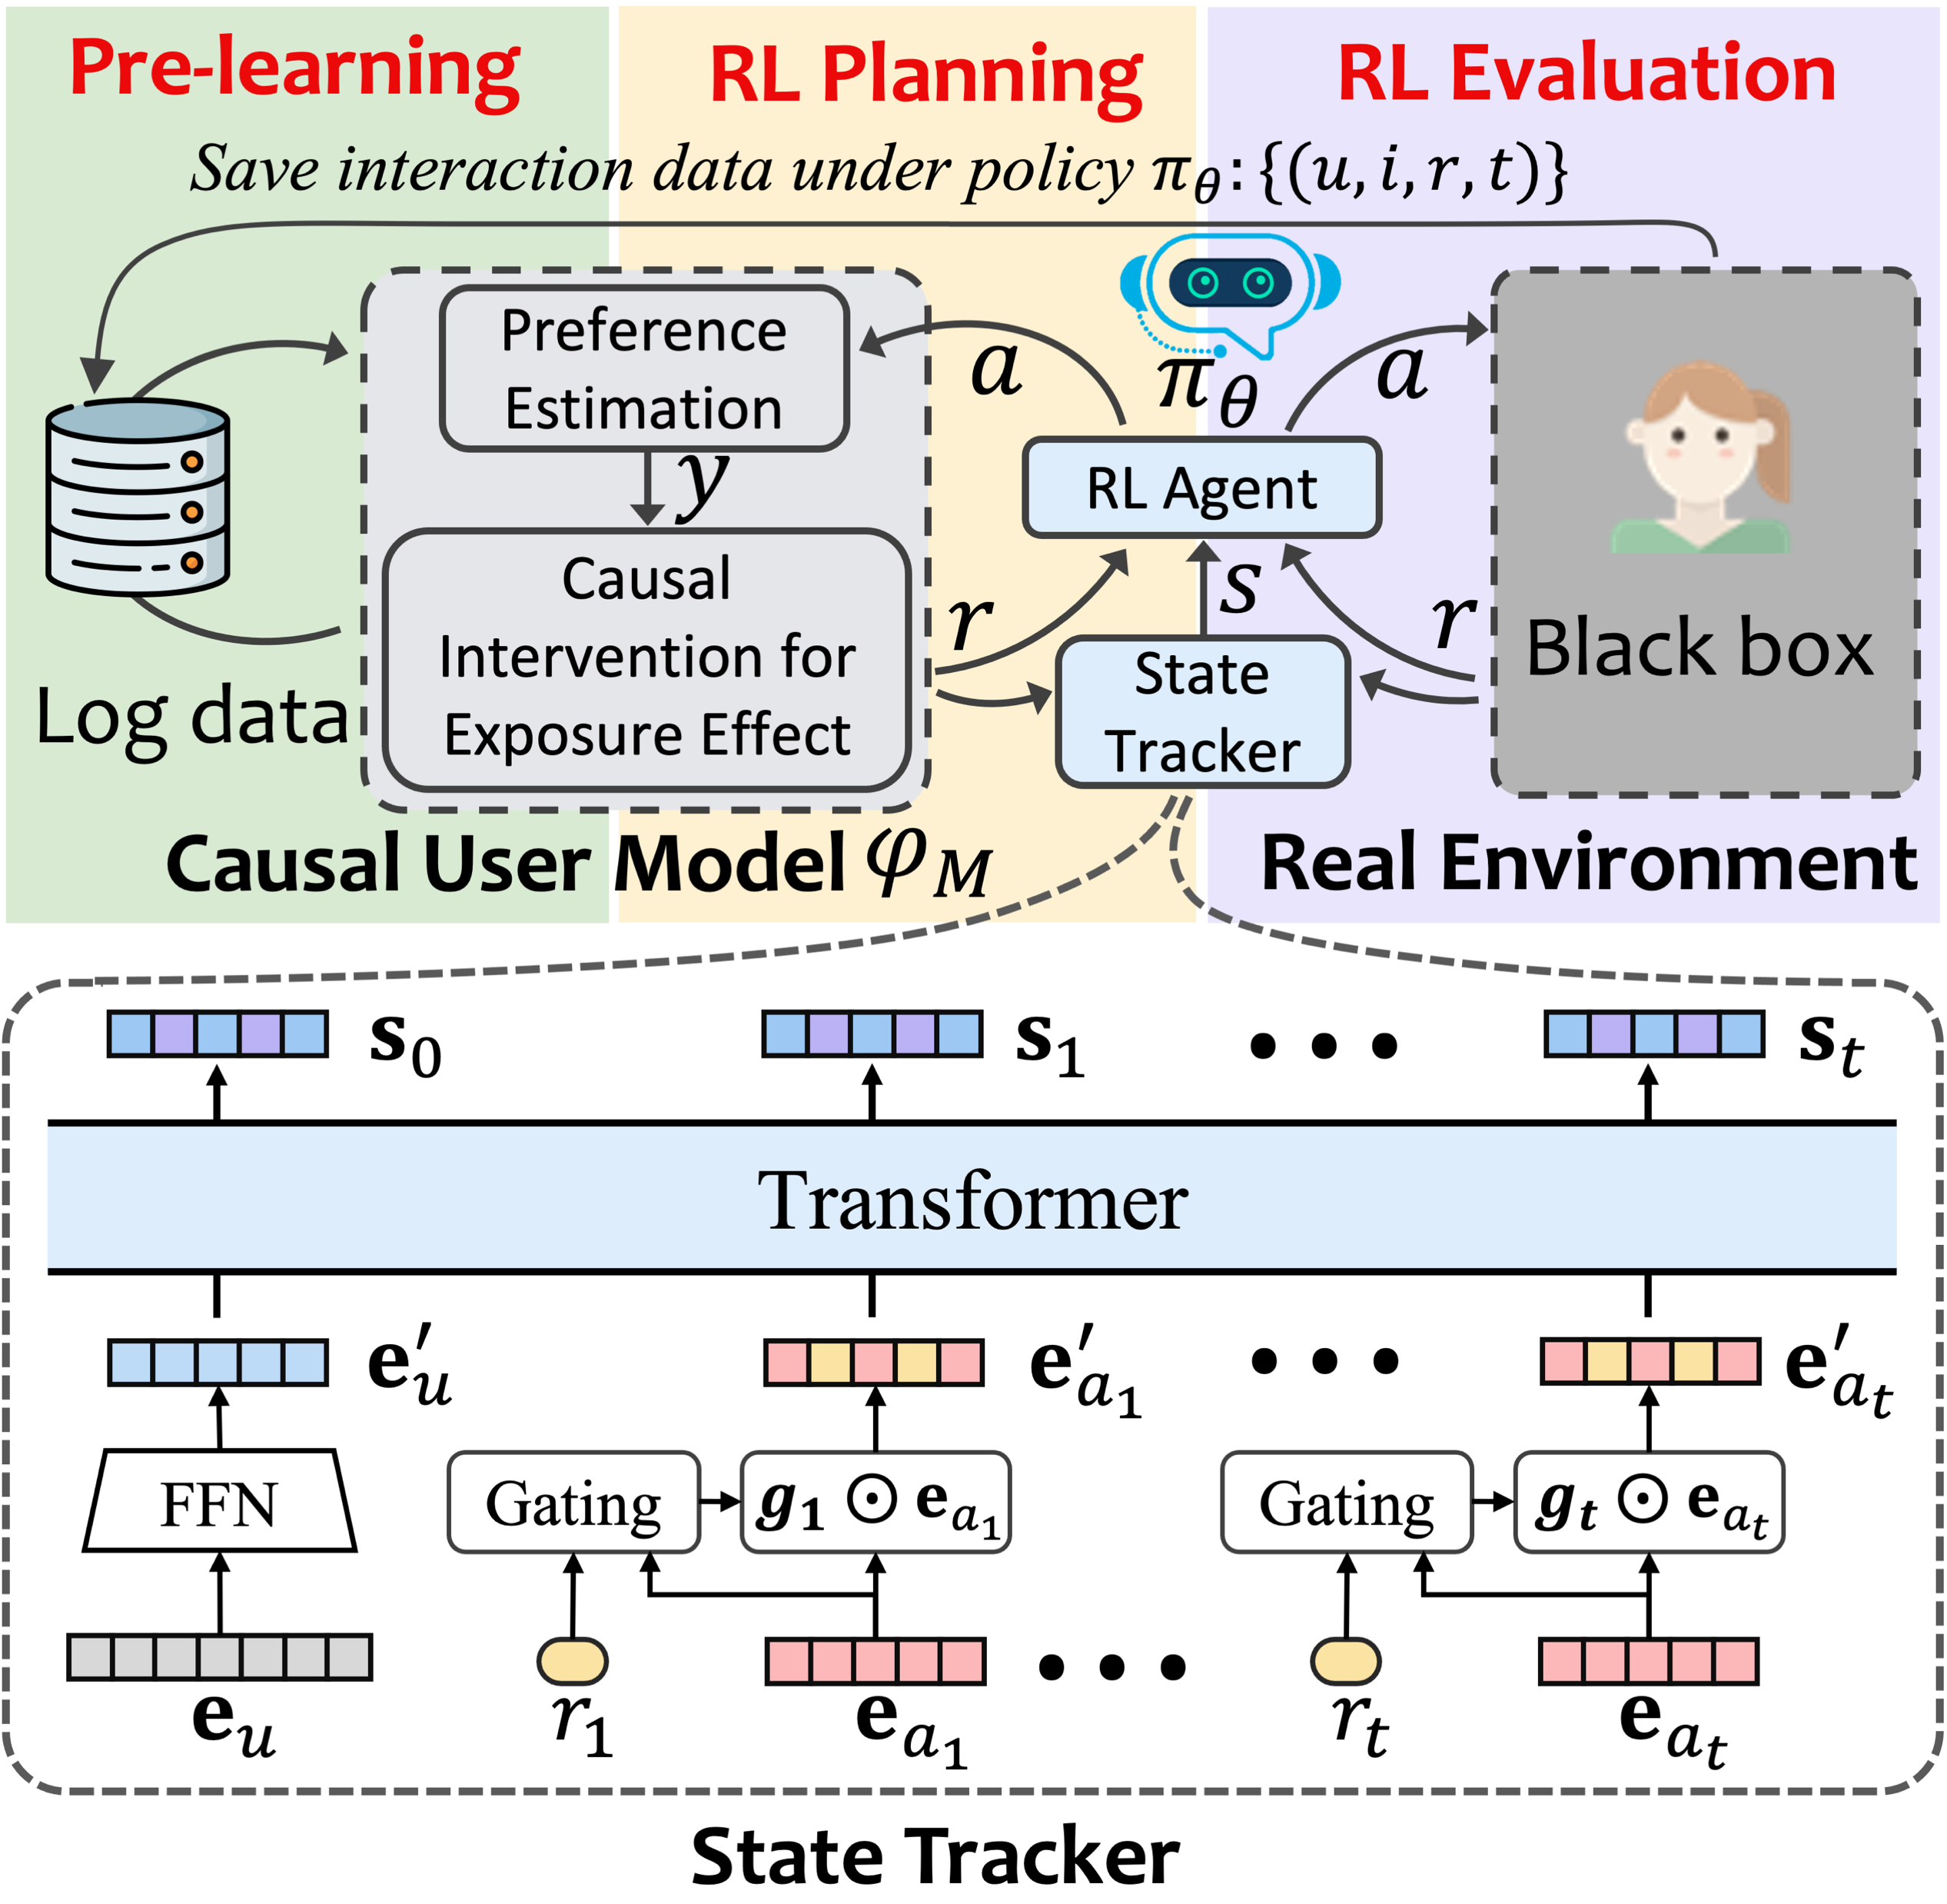










CIRS
DORL
$$a$$
$$P_{E}$$
$$a$$
Entropy Penalizer
Policy $π_{θ}$
Penalize
RL Agent
$$σ_{θ_{3}}^{2}$$
GPM
max
$$P_{U}$$
Pretrain
$$σ_{θ_{2}}^{2}$$
GPM
$$s$$
$$σ_{θ_{1}}^{2}$$
$$\tilde{r}$$
$$\{(x,y)\}$$
GPM
$$f_{θ_{3}}$$
$$f_{θ_{2}}$$
mean
$\hat{r}$
Offline Logs of $π_{β}$
$$f_{θ_{1}}$$
State
Tracker
Ensemble User Model

